Slide 1

UNIVERSITY OF PETROLEUM & ENERGY STUDIES
School of Computer Science
Dehradun
COURSE: Physical Security July – December 2023
Delivered by
Dr. Gopal Singh Rawat
1

Slide 2
Course Plan
CO1. Introduction to Physical Security CO2. Approaches to Physical Security
CO3. Standards, Regulations and Guidelines
CO4. Fire and Fire Safety Inspection CO5. Vulnerability Assessment CO6. Security Surveys and Audit CO7. Security Lighting, Alarms
CO8. Video, Biometrics, Access Control, Fences
CO9. Security Personnel
2

Slide 3
Chapter 6. Security Surveys and Audits

Slide 4
6.1 Security Surveys and Audits
Definition: Systematic evaluation of the security of a company's information systems by measuring how well it conforms to a set of established criteria.
During the audit / examination Auditors note down the following:
Inspect Physical Location – Checklist
Access Threats to the Client Location – 6 specific threats
6.2 NINE Points of Security Concern for Auditor:
#1 Building’s General Purpose
#2 Hazards Associated with building occupants
#3 Application of Guard Security / Police
#4 Recommendations associated with Physical Access
#5 Controls associated with Security Measures
#6 Alarms
#7 Storing Spaces
#8 Measures associated with Trespassing
#9 Custodians

Slide 5
6.2 Security Surveys and Audits
NINE Points of Security Concern for Auditor:
#1 Building’s General Purpose
Who has access to the building
Who is responsible for maintenance
What is the actual use of the building
Who else can access the building
#2 Hazards Associated with building occupants
Identify, List and Prioritize Hazards
#3 Applications of Guard / Police
Use of Guards/Police → improves security
#4 Controls associated with Security Measures
Specific access points – doors, windows
Depends on individual factors
#5 Recommendations associated with Access Controls
Potential use of Alarms
Cost effectiveness of Alarms
Types of Alarms used
#6 Alarms

Slide 6
6.2 Security Surveys and Audits
NINE Points of Security Concern for Auditor:
#7 Storing Space
Problems associated with Storage faced by
organization
#8 Measures associated with Trespassing
Mitigations applied to prohibit trespassing
Security As A Perception
Sign Boards
#9Custodians
Stakeholders, Custodian, Owners

Slide 7


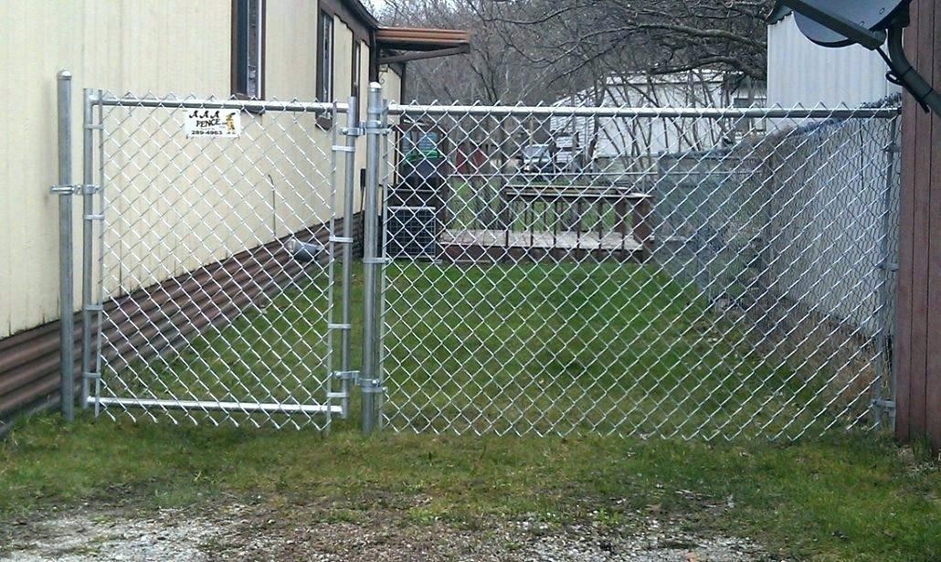
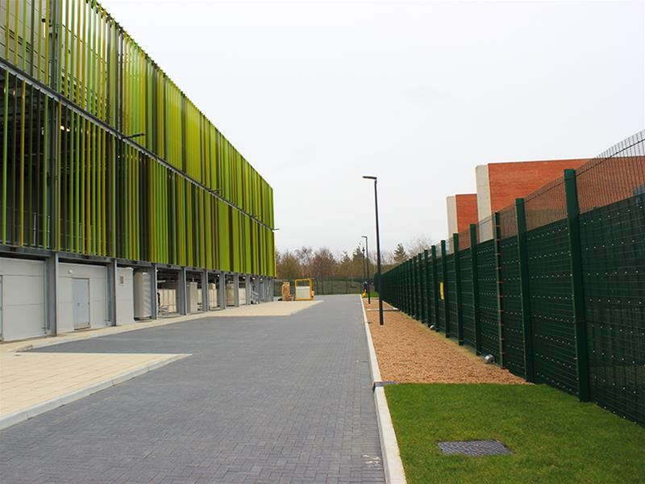
6.3 Physical Security Survey Checklist
Perimeter – Grounds
Are the fence / gate strong and in good condition?
Distance between fence and building – intruder cannot crawl
Boxes / material placed at safe distance from fence?
Any weeds/trash adjoining the building – remove?
Fence Gate hinges secure and non-removable?
Type of locks and chain to secure fence gates
Eliminate unnecessary gates
Are Blind Alley near buildings protected?

Slide 8
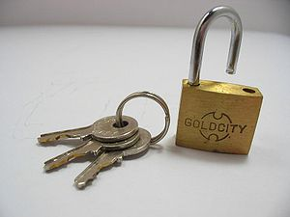
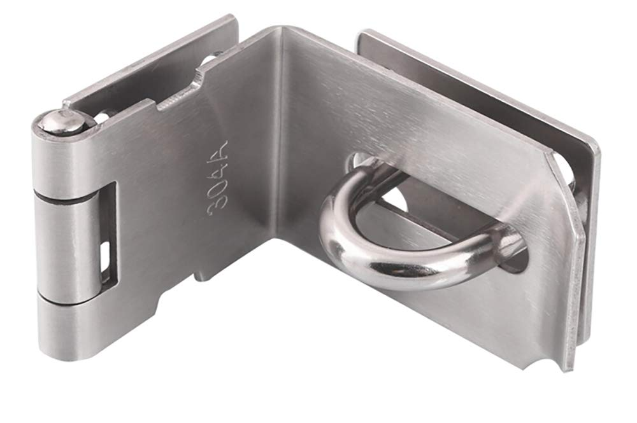
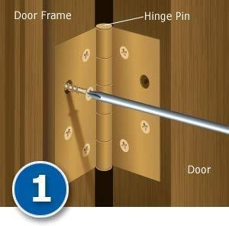
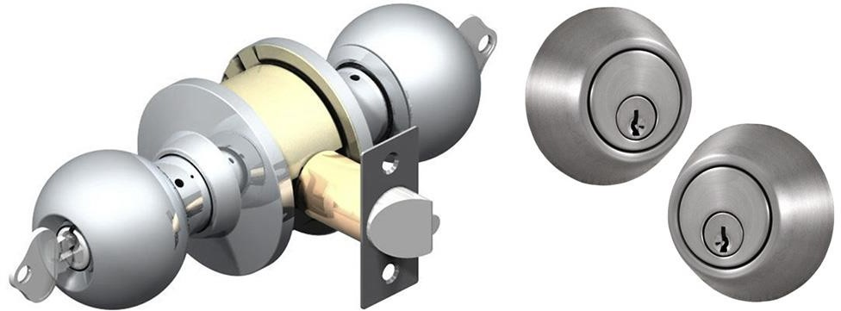
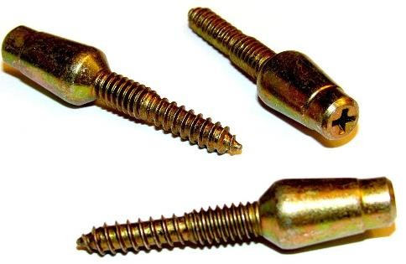
6.3 Physical Security Survey Checklist
Perimeter – Exterior Doors
Are all doors strong and formidable?
Are all door hinge pins located on the inside?
Are all door hinges installed – impossible to remove the doors which are closed?
Are exterior locks double cylinder, deadbolts or jimmy proof?
Are all locks working properly?
Are all doors properly secured and reinforced?
Are the keys in possession of authorized personnel?
Are keys issued only to personnel on duty / those who need the keys?
Are the Padlocks, Chains and Hasps heavy enough?

Slide 9
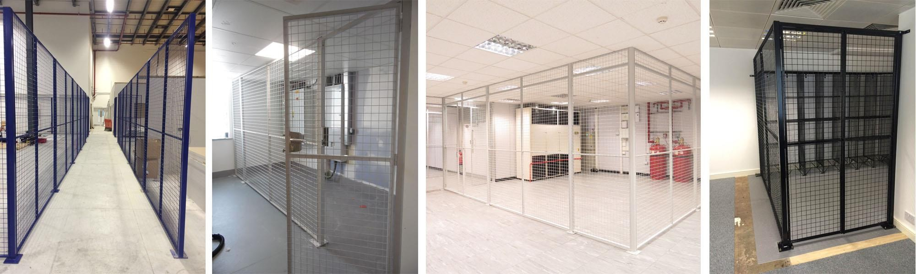
6.3 Physical Security Survey Checklist
Perimeter – Exterior Windows
Are all non-essential windows protected with steel mesh/iron bars or blocked with bricks?
Are all windows within 14 feet of the ground equipped with protective coverings?
Are those windows with locks designed & located so that glass cannot be broken?
Are windows located under loading docks protected?
Are all vents having 1 square feet of area secured?
Are all windows connected to alarms adequately protected?
Are all windows not secured by iron grills/bars kept locked or protected?
Are all windows locked with help of glass, reinforced with shutters?

Slide 10
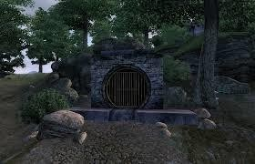
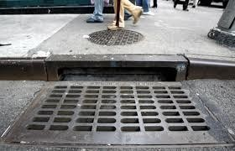
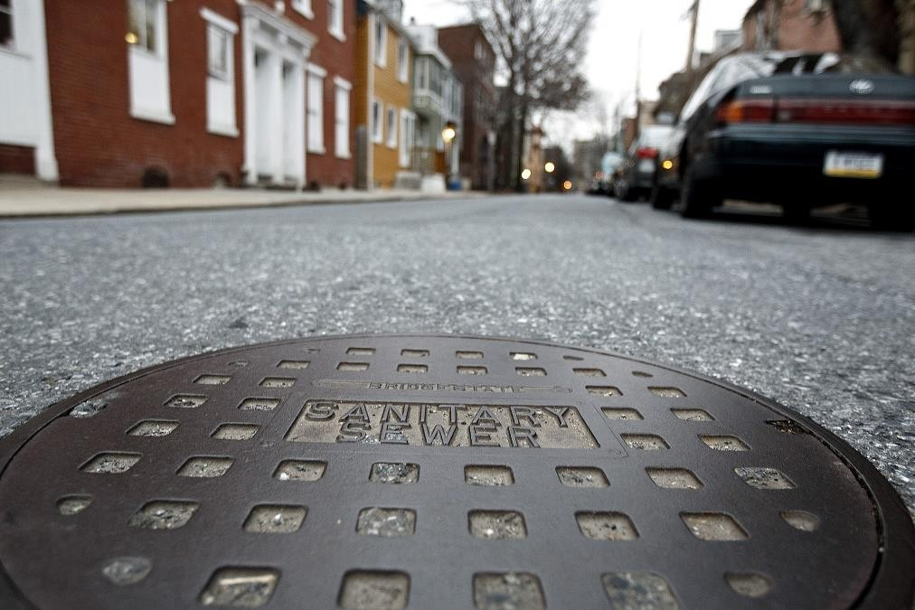
6.3 Physical Security Survey Checklist
Perimeter – Other openings
Are there any manholes or similar openings that provide direct access to the building?
Are manholes or similar openings permanently closed which are no longer used?
Is the sidewalk door or gate securely in place?
Are the accessible skylights protected with bars or an intrusion alarm?
Are exposed roof hatches properly secured?
Are AC or ventilator openings protected?
Are the fire exits or escapes designed so person can leave easily but not enter?

Slide 11

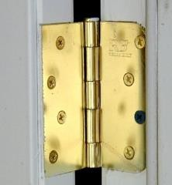
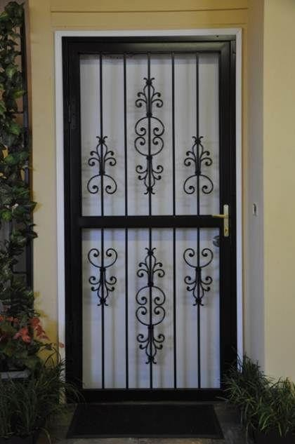
6.3 Physical Security Survey Checklist
Interior – Lighting & Doors
Lighting provided – adequate?
Doors
constructed with solid material?
External doors welded? Iron Door Mesh with wooden door inside?
Door hinges installed inwards?
At least one lock on each door?

Slide 12
6.3 Physical Security Survey Checklist
Interior – Keys, Locks, Safe, Cash
Key Control Register / System? Master Keys? How many have been issued? Log?
Keys marked “Duplicate”?
Loss of Keys reported immediately?
Entrance doors equipped with locks? Always Locked (Default)?
Locks in working order?
Lock combinations changed on employee leaving? Lock locations changed once a year?
Safe Combinations – changed, regularly, can be seen from outside, protective theft alarm?
Is Safe secured to wall or floor?
Petty Cash – funds kept to a minimum, blank signed cheques stored together, storage area secure?
Interior – Inventory Control
When was last time an inventory of business equipment made, listing serial numbers, descriptions, AMC due dates?
Were any items missing or unaccounted for?
Has the site marked all of their business equipment?
Is all expensive business equipment stored in a security cabinet or room?
Notes:
Annual maintenance Contract (AMC)

Slide 13
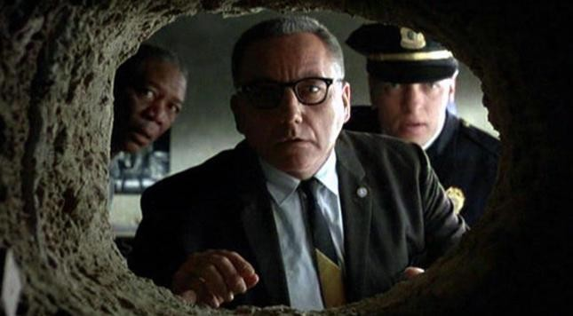
If Physical Security Survey is not performed
What will happen?

Slide 14
6.4 Objectives served by Physical Security Audit
Process of Risk Management
Determine responsibilities and roles of parties involved in running the process
Determine granted access levels
Determine employee awareness of roles and responsibilities
6.5 Level of Threats to Client Location
#1 Nature – Earthquake, Fires, Floods, Lightening, Storms, Draught
#2 Location security – high risk zone, crime zone, VIP areas, Traffic, Street routes
#3 Building condition – deterioration, location and security of door, windows etc
#4 Infrastructure support – Installed Cams, IoT sensors, Access Controls – great idea! Power supply?
#5 Human Resources – trusted, trained, focused
#6 Budget

Slide 15
6.6 Classification of Survey Recommendations
High –
Impacts all OR System / Storage / Office stores confidential OR provides a critical or campus-wide service
Alarm the Perimeter (All Exterior, Interior, Doors. Windows), Elevator/Escalators, Guard at every floor/door
Medium –
Impacts specific people/departments OR System stores non-public or internal-use data, provides internal service
Alarm all doors and windows at the rear, Guard at front entrance & one guard taking perimeter ground rounds
Low –
Impacts single end user OR System processes public data which is easily recoverable and reproducible
Guard at rear entrance

Slide 16
6.7 Fire Safety Inspection
Helps ensure owners and occupiers of budlings are meeting their responsibilities under the legislation
A successful inspection program for fire safety systems requires involvement from facility
Proper recordkeeping provides testing agency with specific system function, layout and equipment that requires testing and inspection
Past inspection provides history of system testing and inspections
Helps identify systems issues that required repair, dates the system repair occurred

Slide 17
Alarm System
Inspection
6.7.1 Fire Safety Inspection Process
Administrative & Planning
Hazardous Material Inspection
General Physical Inspection
Sprinkler Inspection
Extinguisher Inspection
Fire Hose, Control Valve Inspection

Slide 18
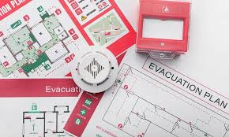
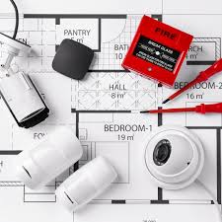
6.7 Fire Safety Inspection
Administrative & Planning Phase
inspection of installed fire safety equipment of the organization
The record of maintenance for each installed fire safety equipment
Security Auditor follows a checklist
Reference copies are maintained or not?
Building code requirements are met or not?
Fire prevention code requirements are met or not?
Life Safety code requirements are met or not ?
All employees have the knowledge of fire safety and prevention plan or not?
Are the personnel responsible given appropriate training?
Is the fire safety plan reworked annually or not?
A fire brigade is maintained or not?
Training is documented or not?
Conduction of refresher training done annually or not ?
Is the training according to latest trends or not?
Does the fire brigade personnel have proper training or not?

Slide 19
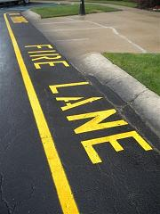
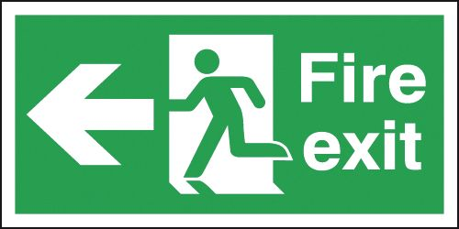
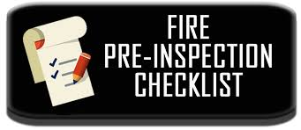
6.7 Fire Safety Inspection
General Physical Inspection Phase
Check structural aspects pf building
Checks level of compliance, Evacuation plans and procedures
Whether marking of the exit routes are done?
Whether the exit routes are unobstructed?
Whether all the systems and security controls associated with fire in compliance?
Whether all the area of service secured when not used?
Having marking done for all the lanes of fire?
Can the department of fire use the master key at any time?
Have the devices which generate heat being placed according to the amount of heat generated?
Is the cleaning and inspection of ducts done on a regular basis?
Is there an extension cords in any area?
Is the inspection of all items which are operated thru electricity and all electrical cords done?

Slide 20
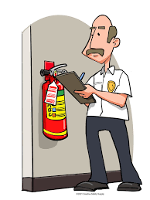
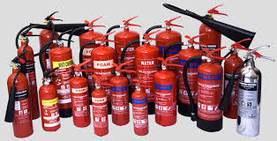
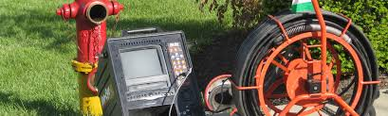
6.7 Fire Safety Inspection
Extinguisher Inspection Phase
Check fire extinguisher
Checks level of compliance, Evacuation plans and procedures
Whether fire extinguisher serviced in past 12 months by a licensed technician?
Whether inspection of fire extinguisher conducted routinely?
Whether the right type of extinguisher is placed appropriately?
The training of person appointed to use the fire extinguisher been proper ?
Inspection Phase of Fire hose, Stand pipe and control valve
Are the control valves monitored by tamper switches?
Is the testing and inspection of control valves done on a daily basis?
Is the accessibility of fire hose , stand piper and control valve done in a good way?
Is the recommendations of manufacturer taken for decaying and weaking of all fire hoses?

Slide 21
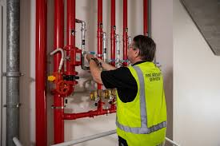
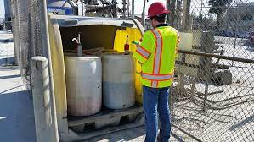
6.7 Fire Safety Inspection
Inspection Phase of Sprinkler System
Is the testing and inspection of flow switches done or not?
Is the location being judged correctly or not?
Is the maintenance of sprinkler head done or not?
Is a clear operation area provided to the sprinklers or not?
Is a pump which maintains the pressure being employed or not?
Is the testing and inspection of pump done after a period of time ?
Is coverage provided to all the areas which require coverage of water sprinkler system?
Hazardous materials inspection phase
Is proper utilization of placard that warn done?
Is the utilization and maintenance of the response to situation of emergency and fire safety done?
Personal Protective Equipment PPE is provided or not?
PPE’s training is given or not?
Is the documentation of PPE training done or not?
Are the areas of storage, area of usage and area where the hazardous material kept is shared with department of fire or not?
Is the utilization of distance of standoff, containers and signals of warning done in an appropriate manner or not ?

Slide 22
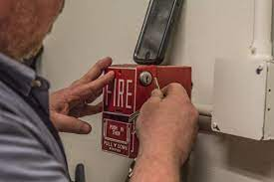
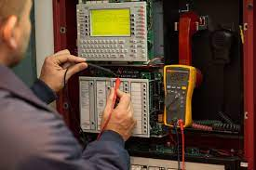
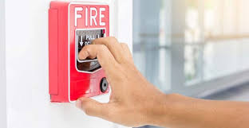
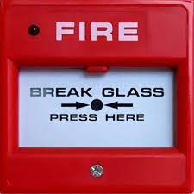
6.7 Fire Safety Inspection
Alarm System Inspection Phase
Is a service of monitoring used to monitor the system?
Is a trained technician employed to monitor the system?
Has a secure location chosen for keeping the documents of the inspection?
Has the zones that can be identified being made?
Can the location of the fire be clearly identified?

Slide 23
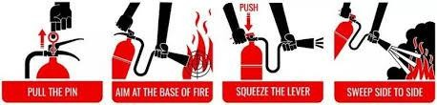
6.8 Fire Suppression Techniques
Fire Extinguisher:
PASS TECHNIQUE:
Pull
Aim
Squeeze
Sweep
Fixed Systems:
Water Sprinklers (expensive) → Halogen Gas (damages Ozone layer)
Now → Waterless Environment Friendly FM-200 Thermal Compound – Aircraft, Vehicles, Offices.

Slide 24
6.9 Fire Safety Report
Has policies and procedures related to the organization
Objective – Perform critical appraisal of Employees, Systems, Policies, Ensure safety and health
Scope of Work (SoW)
Fire Hazard Identification | Fire Fighting System | Fire Detection and Alarm system
Gas Suppression System | Fire Extinguisher | Passive Fire Protection
Emergency Management | Life Safety system
Methodology – process of carrying out audit
Pre-site visit
Site visit
Face to face, Discussion, Note observations
A → existing non-compliance, deviations from defined procedures/policies
B → deviations from practices provided by national/international bodies (ISO/PCI)
C → based on good practices followed by peers / similar industry
Present Report with recommendations for three categories to address:

Slide 25
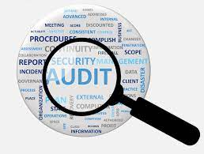

6.10 Recommendation Aspects
Positive
Data breach minimized significantly
Revenue and Security Reputation of organization is increased
Unauthorized personal kept away
Employees feel safe during their work and environment is secure
Intellectual property of an organization can be saved
Negative
Employees may feel been roped down
Operational procedures are confusing
Psychological barrier in employees' minds regarding policies
Work and production can get affected

